Slide 1
Do now
Clarence and his friends have always been way more interested in girls than in graduating, so they decide to spend all of their time and focus on trying to date as many girls as possible. They start to wonder if there is anything they can change about themselves to make it more likely that a lady would say yes to their date requests. After some careful consideration, Clarence and the group came to the conclusion that the type of clothes they wear will make a big difference. So, half of the group spends the month wearing their normal ‘greaser’ clothes and asking out one girl a day. The other half of the group spends the month wearing goth apparel and asking out one girl a day. At the conclusion of the experiment, a tally is made of how many girls accepted the requests of each group.
Identify IV and DV
List 3 possible extraneous variables
Identify the experimental and control group
Write a hypothesis for this study
Reminders:
Phones away
Bags on floor
Books out
Pens out
Whiteboard

Slide 2
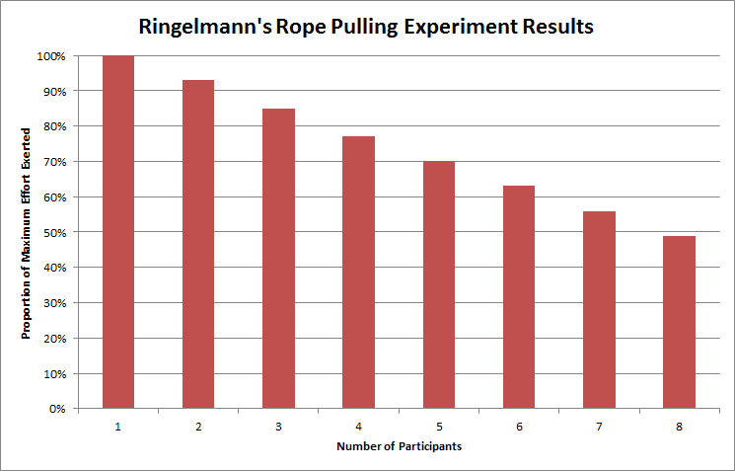
DO NOW
Reminders:
Phones away
Bags on floor
Books out
Pens out
Whiteboard
Describe one trend in the data
Identify two findings from the results above
Outline a conclusion for this study

Slide 3
Do now
1. Give two examples of descriptive statistics
2. Give one example of an inferential statistic
3. What if the role of a P value in research?
4. Interpret the following:
P > 0.05
P < 0.003
P < 0.2

Slide 4
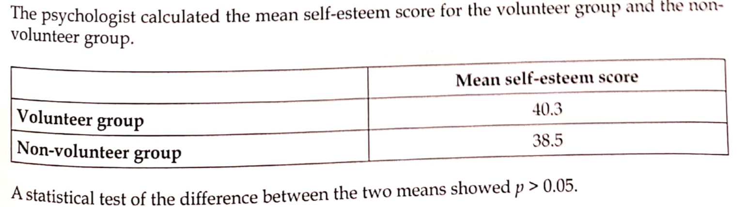

Slide 5
Answers
No, the results are not statistically significant
2. Statistical significance relates to whether or not the results are probably due to chance / extraneous variables or due to the manipulation of the IV. Statistical significance allows you to accept or reject your hypothesis with confidence and relate the findings to the greater population.
3. The results are due to chance and not the manipulation of the IV as there is more than 5% probability the results are due to chance.

Slide 6

Success Criteria
Learning Intention
By the end of the lesson I will be able to:
Practice my data interpretation skills
Skim read journal articles and outline the research
Skim read and outlined at least 2 pieces of research
Engaged in the do now questions
Marked my data interpretation test

Slide 7
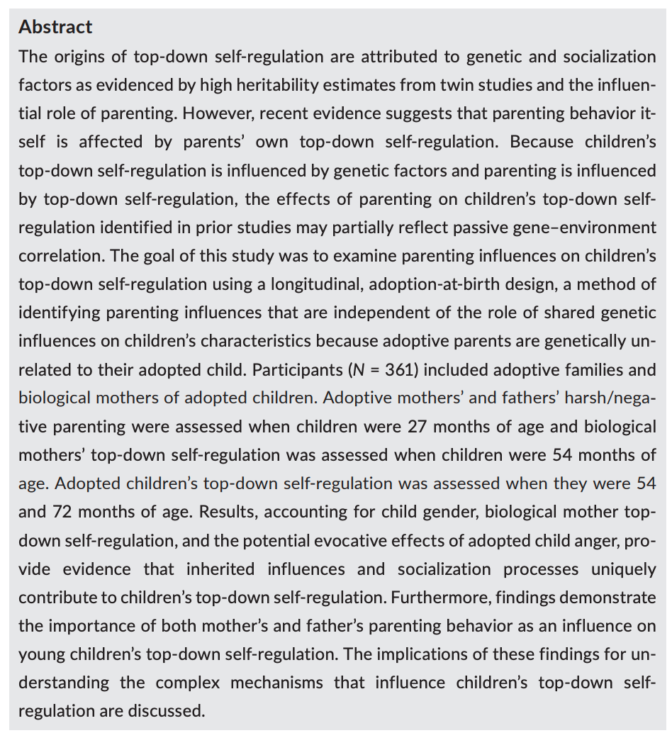
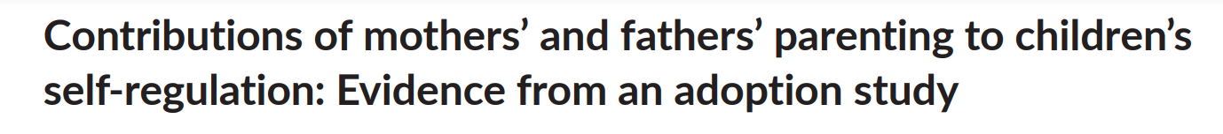
Skill: Skim reading and summarizing research
Skill Development – teacher led
When skim reading research papers the abstract should include most of the key information you need.
Key information to look for:
Aim
Participants
Procedure
Results
Conclusion
Author(s) and year
Tip: When you stumble on words you don’t know.
Make a note, but keep reading.

Slide 8


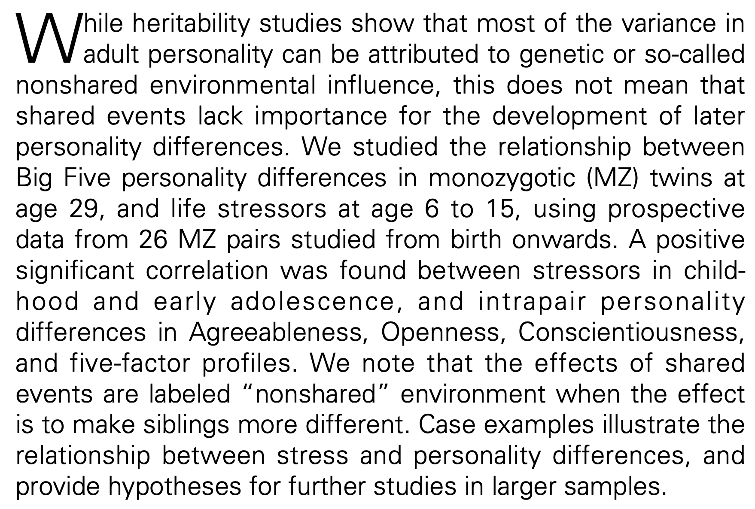
Skill: Skim reading and summarizing research
Skill Development / paired work
When skim reading research papers the abstract should include most of the key information you need.
Key information to look for:
Aim
Participants
Procedure
Results
Conclusion
Author(s) and year
Tip: When you stumble on words you don’t know.
Make a note, but keep reading.

Slide 9
Station activity

Slide 10
Finish your research methods test
Mark the test
Or
Outline the research on SEQTA

Slide 11

Exit Ticket
Write a research methods test question
ASK ONE GET ONE

